Slide 1
CHAPTER 8 - ANTENNAS
CHAPTER 7 Review
Characteristic Impedance, Z₀, which is dependent only on conductor dimensions, transmission line geometry and dielectric materials.
Not dependent on transmission line length or load impedance.

Slide 2
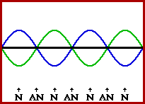
CHAPTER 8 - ANTENNAS
CHAPTER 7 Review
If Z_{L} = Z₀, all power launched into the transmission line will be absorbed by the load.
If Z_{L} ≠ Z₀, a portion of the incident power will be reflected at the load and standing waves will result.

Slide 3
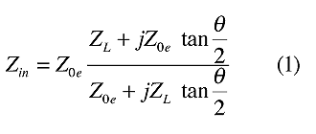
CHAPTER 8 - ANTENNAS
CHAPTER 7 Review
Recall that there are hard ways to identify the amount of mismatch:
Impedance

Slide 4
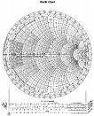
CHAPTER 8 - ANTENNAS
CHAPTER 7 Review
Recall that there are easy ways to identify the amount of mismatch:
Smith Chart

Slide 5
CHAPTER 8 - ANTENNAS
CHAPTER 7 Review
Recall that there are easy ways to measure the amount of mismatch:
VSWR (SWR)
An SWR meter measures, by direct or indirect methods, if SWR is an issue and by how much.
A TRANSMATCH allows us to transform and null out the mismatch until the SWR is reasonable.

Slide 6
CHAPTER 8 - ANTENNAS
The Antenna
An antenna is a device which performs two functions:
  It converts the Radio Frequency energy from your transmitter into radio waves to be radiated by the antenna.
  It converts radio waves from free space into an electrical current to be processed by your receiver.

Slide 7
CHAPTER 8 - ANTENNAS
The Antenna
An antenna has the convenient behaviour in that many of its characteristics are the same for transmitting as receiving.
This makes it easy for us to measure or calculate these characteristics.

Slide 8
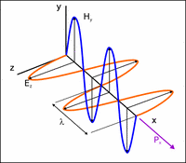
CHAPTER 8 - ANTENNAS
The Electromagnetic Wave
An electromagnetic (radio) wave is made of an electric field E, and a magnetic field H. A Sine wave.
They are mutually perpendicular and transverse to the direction of propagation.
They are in phase.

Slide 9
CHAPTER 8 - ANTENNAS
The Electromagnetic Wave
They propagate at the speed of light – 286,000 mi/s or 300,000,000 m/s. This is the free space velocity.
λ=c/f
  where:
  λ is the wavelength (m)
  c is the speed of light (m/s)
  f is the frequency (Hz)

Slide 10
CHAPTER 8 - ANTENNAS
Polarization
…is the orientation, with respect to the local horizon, of the electric field in a propagating electromagnetic wave.
Polarization can be vertical, horizontal, elliptical (left hand and right hand) and circular.

Slide 11
CHAPTER 8 - ANTENNAS
Polarization
A receiving antenna will capture the most energy of a signal when it shares the same polarization with that received signal.
With a direct or ground wave, this polarization will be the same as the transmitting antenna.
With a skywave signal, that polarization will be random.

Slide 12
CHAPTER 8 - ANTENNAS
Imaginary Antennas
Isotropic Antenna
  A hypothetical antenna that radiates or receives equally in all directions.
  Isotropic antennas do not exist physically but represent a convenient reference antenna for expressing directional properties of physical antennas.
  The radiation pattern for the isotropic antenna is a sphere with the antenna at its center.

Slide 13
CHAPTER 8 - ANTENNAS
Imaginary Antennas
Elementary Dipole
  An antenna too short, for the frequency of interest, to be of practical value.
  They are, however, used in antenna (numerical) modelling to calculate characteristics of real antennas.

Slide 14
CHAPTER 8 - ANTENNAS
Main Characteristics of an Antenna
Antenna Impedance
  It may be purely resistive, or resistive with a reactive (inductive or capacitive) component.
  An antenna is said to be resonant if it displays no reactive component. That is, its impedance is purely resistive.

Slide 15
CHAPTER 8 - ANTENNAS
Main Characteristics of an Antenna
Antenna Impedance
  The resistive portion of the impedance, is made up of a radiation resistance and a loss resistance.
  The radiation resistance is an imaginary resistance. The power “dissipated” in this resistance is the power actually radiated from the antenna.
  The loss resistance is made up of resistances of the conductors used to make the antenna and other losses in the antenna system. The power dissipated in these resistances is lost, wasted as heat.

Slide 16
CHAPTER 8 - ANTENNAS
Main Characteristics of an Antenna
Antenna Impedance
  The impedance will vary with frequency.
  The radiation resistance varies relatively little with frequency, but the reactance varies much more with frequency – capacitive below resonance and inductive above – increasing the SWR either side of resonance.

Slide 17
CHAPTER 8 - ANTENNAS
Main Characteristics of an Antenna
Antenna Bandwidth
  Is defined as the frequency range or span at which the SWR remains at or below 2:1.
  Antennas can be purposely built to be broad-band (relatively speaking) or narrow-band.
  There are other, less often used definitions such as SWR bandwidth, Gain bandwidth, F/B ratio bandwidth.

Slide 18
CHAPTER 8 - ANTENNAS
Main Characteristics of an Antenna
Antenna Directivity (Gain)
  Is the ability to direct or focus radiated energy in a specific direction or directions.
  The measure of the intensity of the directivity is referred to as the gain of the antenna.
  This gain works for the antenna in receiving signals as well.

Slide 19
CHAPTER 8 - ANTENNAS
Main Characteristics of an Antenna
Antenna Gain
  gain is the logarithm of the ratio of the intensity of an antenna's radiation pattern in the direction of strongest radiation to that of a reference antenna.
  If the reference antenna is an isotropic, gain is expressed in units of dBi (decibels over isotropic).
  Sometimes the unit dBd is used, indicating gain over that of a dipole.
  The radiation pattern (a graphical representation of the gain) can be determined analytically or experimentally.

Slide 20
CHAPTER 8 - ANTENNAS
Main Characteristics of an Antenna
Antenna Beamwidth
  The width of the main lobe of radiation.
  Usually measured in degrees.
  Measured from the points where the radiation is at half power, or 3 dB down from the maximum.

Slide 21
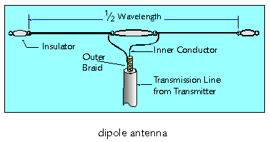
CHAPTER 8 - ANTENNAS
Introducing the Dipole Antenna
Invented by Heinrich Rudolph Hertz © 1886.
AKA the Doublet or Hertzian antenna.
Transmission line attaches to the center.
Approximately λ/2 in length.

Slide 22
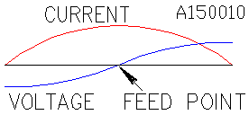
CHAPTER 8 - ANTENNAS
The Dipole Antenna
When a dipole is excited at its resonant frequency, standing waves, as shown, are produced.
Note that:
  the current at the ends is near 0 and maximum in the center
  and that the voltage is the opposite (ie, they are 90 degrees out of phase).

Slide 23
CHAPTER 8 - ANTENNAS
The Dipole Antenna
Recall that the apparent impedance is voltage divided by the current. This means that this antenna presents a low impedance (approx 73 Ω in free space) when fed at the center terminals, as shown.
We could also feed the antenna from either end (don’t ask yet how), and this would result in a high impedance (on the order of thousands of ohms).

Slide 24
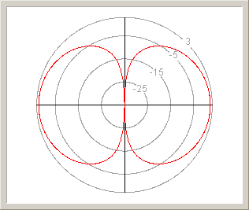
CHAPTER 8 - ANTENNAS
The Dipole Antenna
This diagram shows the dipole’s directivity (from above)– called its radiation pattern. It is in the shape of a doughnut or torus, with the antenna through the middle.
Note:
  the wire is oriented up/down in the diagram – maximum radiation is in two directions.
  This scale is in units of dBi. The gain of the dipole is 2.15 dBi - it has a gain of 2.15 dB (in the direction of it’s main lobes) over an isotropic antenna.

Slide 25
CHAPTER 8 - ANTENNAS
The Dipole Antenna
The Front to Back Ratio (F/B) is a ratio (in dB) of the gain of the major lobe to the gain in the opposite direction.
The dipole has no F/B ratio because it is bidirectional, but many other antennas are unidirectional.
The beamwidth is approx 80 degrees (each way).

Slide 26
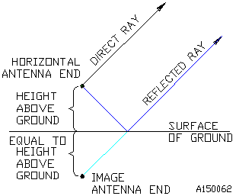
CHAPTER 8 - ANTENNAS
The Dipole Antenna
The effect of the ground, when the antenna is mounted at practical heights (below 10 λ), is to reflect the signal. It is as if there were an image of the antenna below the surface.
The presence of this image antenna tends to lower the feedpoint impedance of the dipole.
The combination of the direct wave and reflected wave tends to tilt the radiation upwards.

Slide 27
CHAPTER 8 - ANTENNAS
Polarization
The polarization of a horizontally erected dipole antenna is horizontal.
The polarization of a vertically erected dipole antenna is vertical.
Generally, the polarization of an antenna takes on the orientation of the antenna’s (main or driven) conductor.

Slide 28
CHAPTER 8 - ANTENNAS
The Dipole Antenna
Recall that the dipole has a radiation resistance of approx 73 Ω (lower at practical heights). What is its bandwidth and how do we change it?
Think of the capacitance of the dipole’s “resonant circuit” as being between the two legs, and the inductance as being in series with the two legs.
If the two legs were made of large diameter wire (tubing, for example), the capacitance would increase and inductance decrease.
Hence, the reactance of the “resonant circuit” would be lower, the Quality Factor (Q) would be lower, and the bandwidth greater.

Slide 29
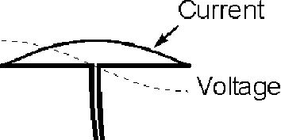
CHAPTER 8 - ANTENNAS
Feeding the Dipole Antenna
A dipole has an impedance of approx 73 Ω in free space (lower at practical heights – less than 10λ).
If we use 50Ω coaxial cable, the resulting SWR would only be 1.5 to 1 (75/50= 1.5). Remember to use a balun!
We could use 75Ω coaxial cable and get an SWR of 1 to 1. The reduction in power (at the transmitter) would be less than 5% (remember the maximum pwr transfer theorem).

Slide 30
CHAPTER 8 - ANTENNAS
Constructing the Dipole Antenna
Two things tend to affect the required length of conductor required to be resonant at a particular frequency:
  the diameter to length ratio of the conductor and
  end effect.

Slide 31
CHAPTER 8 - ANTENNAS
Constructing the Dipole Antenna
Diameter to Length Ratio:
  If the conductor were infinitely thin, the free space formula for one-half wavelength would accurately predict the required length for a half-wavelength antenna. However, as the diameter of the conductor increases, the required length becomes less .
End effect:
  affecting mainly HF wire antennas that must be supported from the ends, results in a capacitance at the end from the supporting method used that also tends to shorten the required length.

Slide 32
CHAPTER 8 - ANTENNAS
Constructing the Dipole Antenna
Above 30 MHz, practice has shown that common construction methods require no modification of the formula.
  Hence λ/2 = 150/f (MHz) m
Below 30 MHz, practical construction techniques require a shortening of the formula by about 5%.
  Hence λ/2 = 143/f (MHz) m
The higher the frequency the shorter the antenna and vice versa.

Slide 33
CHAPTER 8 - ANTENNAS
Constructing the Dipole Antenna
For self supporting Dipoles,
  make the elements adjustable in length. Then adjust them for low SWR.
For wire Dipoles,
  Make the elements longer than calculated. Then cut them or fold them back for low SWR.

Slide 34
CHAPTER 8 - ANTENNAS
The Dipole – Pros and Cons
Pros:
  It is easy to construct, using common materials.
  Tolerant of imperfect mounting.
Cons:
  Must be supported at both ends and sometimes in the middle, as well.
  Operates generally only on a single band.

Slide 35
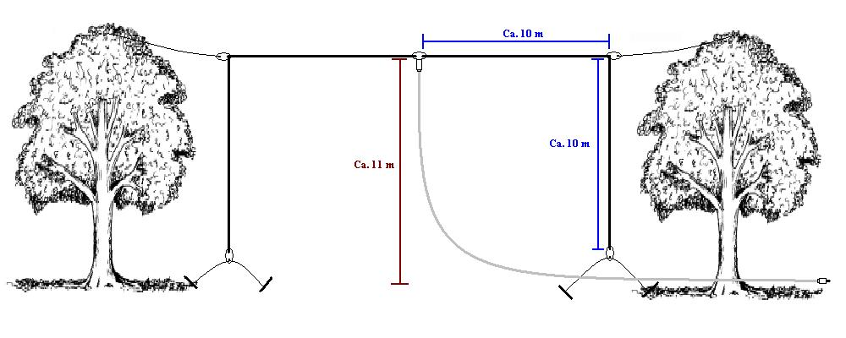
CHAPTER 8 - ANTENNAS
Dipole Problems
I don’t have enough room.
  Let the ends drop.

Slide 36
CHAPTER 8 - ANTENNAS
Dipole Problems
I don’t have enough room.
  Use loading coils.
  Recall that an antenna that is too short is capacitive. Adding inductance brings the antenna back into resonance.

Slide 37
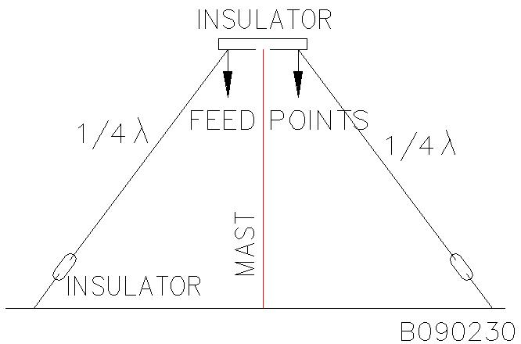
CHAPTER 8 - ANTENNAS
Dipole Problems
I don’t have enough room/ I have only one support.
  Make an inverted Vee.
  The drooping of the legs present an impedance closer to 50 Ω.

Slide 38
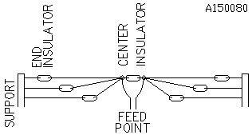
CHAPTER 8 - ANTENNAS
Dipole Problems
I want to operate on more than one band.
  Use multiple dipoles.
  There is sometimes interaction in the resonance between the dipoles.

Slide 39
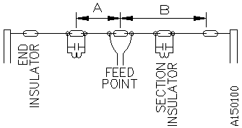
CHAPTER 8 - ANTENNAS
Dipole Problems
I want to operate on more than one band.
  Use a Trap Dipole.
  The parallel resonant circuits isolate parts of the dipole so that they are “in circuit” at different frequencies.

Slide 40

CHAPTER 8 - ANTENNAS
Other Antennas
Folded Dipole
  A half wave in length.
  The impedance is 300 Ω, dependent on the relative diameter and spacing of the conductors. Hence, some impedance matching is necessary.
  Because it’s “fatter” than a wire dipole, it has greater bandwidth.
  Other characteristics, such as radiation pattern and polarization, are similar to that of the regular dipole.

Slide 41
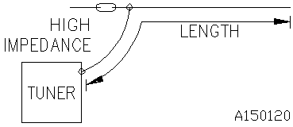
CHAPTER 8 - ANTENNAS
Other Antennas
End Fed Long Wire
  Also called a long or random wire antenna.
  Simply place a wire as high and as long as you can, bending it to gain length if possible.
  It may not be tunable on all bands.
  Radiation pattern and polarization are not predictable.
  It may generate RF in the shack

Slide 42
CHAPTER 8 - ANTENNAS
Other Antennas
Vertical Dipole
  If we mount a dipole vertically on the ground, the resulting radiation pattern will be omnidirectional.
  Some of the tricks we used with the horizontal dipole to shorten it (loading coils), make it multiband (traps) or wideband (folded dipole) can also be used on this antenna.
  Vertical polarization.

Slide 43
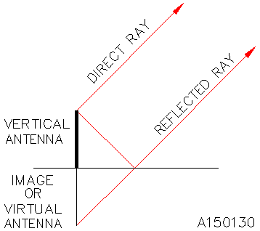
CHAPTER 8 - ANTENNAS
Vertical Antennas
Recall that, when operated in the vicinity above ground, an image of the antenna is formed.

Slide 44
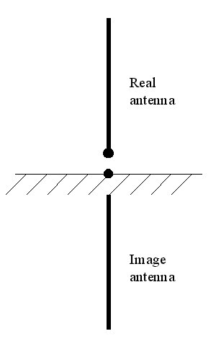
CHAPTER 8 - ANTENNAS
Vertical Antennas
We can take advantage of that image to shorten the length of a vertical dipole. The image is used to form the lower half of the dipole.
This is known as a monopole antenna.
Because, physically, it is only half of a dipole, the radiation resistance is half of 73 Ω or approximately 36 Ω.

Slide 45
CHAPTER 8 - ANTENNAS
Vertical Monopole
Because the ground is not a perfect conductor, the vertical monopole suffers from loss resistance.
This adds with the radiation resistance (36Ω) and often makes the monopole easier to match – it’s resistance at resonance approaches 50Ω.
When the loss resistance becomes a significant portion of the total, the vertical monopole suffers from poor efficiency.

Slide 46
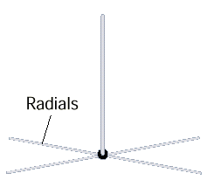
CHAPTER 8 - ANTENNAS
Vertical Monopole
A radial wire system – a number of conductors laid radially out from the base of the antenna – can be used to reduce ground losses locally.
The longer and more numerous the conductors, the better. They can be on top or just below the surface.
This increases antenna efficiency, but has the side effect of lowering the feedpoint impedance back down towards 36Ω.

Slide 47
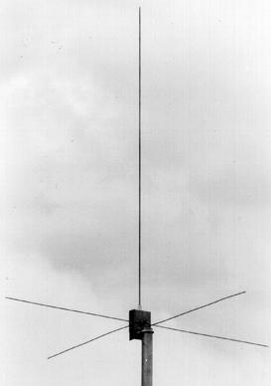
CHAPTER 8 - ANTENNAS
Vertical Monopole
A ground plane – quarter wavelength rods or wires mounted radially out from the base of the antenna – helps to generate the missing image in antennas mounted above ground.

Slide 48
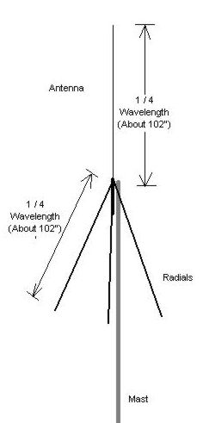
CHAPTER 8 - ANTENNAS
Vertical Monopole
To make the antenna a better match to 50 Ω coaxial cable, the radials of the ground plane can be angled downwards.
If we angle the radials to the extreme, we see that this would become a half-wave dipole, again, with a feedpoint impedance of 73 Ω.

Slide 49
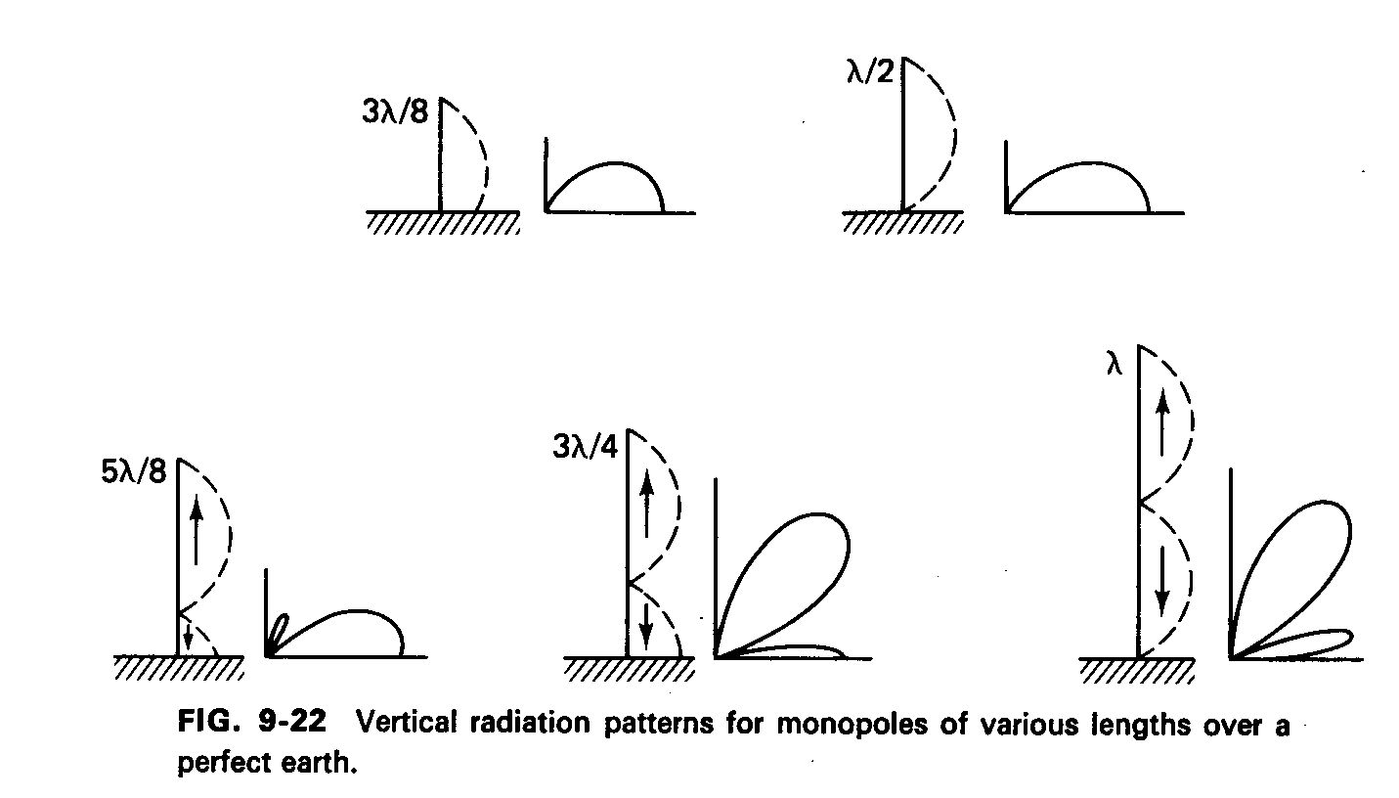
CHAPTER 8 - ANTENNAS
Vertical Monopole
Lengthening the element of a monopole has some advantages.
But only so far.

Slide 50
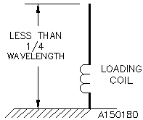
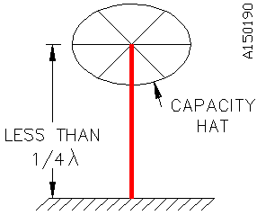
CHAPTER 8 - ANTENNAS
Vertical Monopole
We can also use some of the same tricks with the monopole that we used with the dipole.
  Loading coil
  Capacitance hat
Both of these act to electrically lengthen the conductor.

Slide 51
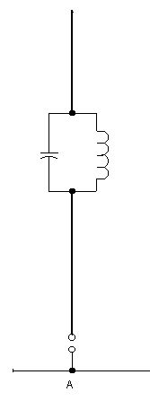
CHAPTER 8 - ANTENNAS
Vertical Monopole
We can also use some of the same tricks with the monopole that we used with the dipole.
  Traps
This allows the monopole to present a reasonable impedance and radiation pattern on more than one band.

Slide 52
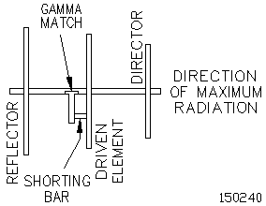
CHAPTER 8 - ANTENNAS
Other Antennas
There are other ways to acquire gain from an antenna.
With the right length and spacing relative to a dipole antenna, a conductive element will tend to reflect electromagnetic waves back in the direction of the dipole.
This is called a reflector.

Slide 53
CHAPTER 8 - ANTENNAS
Other Antennas
There are other ways to acquire gain from an antenna.
With the right length and spacing relative to a dipole antenna, a conductive element will tend to direct electromagnetic waves away from the direction of the dipole.
This is called a director.
The reflector and director are known as parasitic elements.

Slide 54
CHAPTER 8 - ANTENNAS
The Yagi-Uda Antenna
This is known as a Yagi-Uda antenna. Named after its inventors Hidetsugu Yagi and Shintaro Uda.
It is commonly known as, simply, the Yagi antenna.
In its basic form, it is made with three elements: a director, driven element and a reflector.
The object that supports the elements is known as the boom.

Slide 55
CHAPTER 8 - ANTENNAS
The Yagi-Uda Antenna
The director is typically 5% shorter than the driven element and is placed 0.2 λ in front of it.
The reflector is typically 5% longer than the driven element and is placed 0.2 λ behind it.
Optimized designs, which vary the element lengths, spacing and number, seek to obtain smaller size, greater gain, F/B ratio, or bandwidth.
Longer booms result in “more behaved” designs.

Slide 56
CHAPTER 8 - ANTENNAS
The Yagi-Uda Antenna
The presence of conductors so close to the driven element will affect the feedpoint impedance.
Numerous schemes are used to match the antenna to the transmission line. Here, something known as a gamma match, is used.

Slide 57
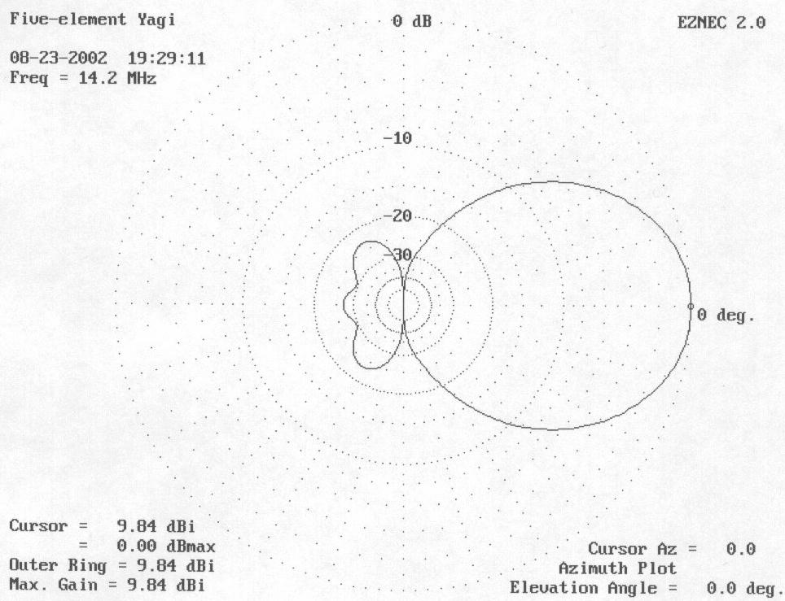
CHAPTER 8 - ANTENNAS
The Yagi-Uda Antenna
Higher gain Yagis are most easily obtained by lengthening the boom and adding directors (within reason).
Here is the radiation pattern of a 5-element Yagi (3 directors) for the 20m band.
It has a forward gain of about 10dbi and a F/B ratio of 27 dB.
The gain, F/B ratio and the number and location of minor lobes can vary significantly within a band.

Slide 58
CHAPTER 8 - ANTENNAS
The Yagi-Uda Antenna
Can we get more gain?
  Yes, if we stack Yagi antennas beside or above one-another, we can get 3 dB of gain.
Or, we can look in to the Loop Antenna

Slide 59
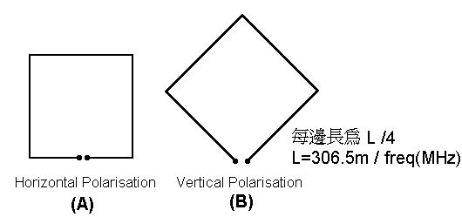
CHAPTER 8 - ANTENNAS
The Loop Antenna
Compare the gain of a square loop to that of a dipole.
  The loop has an approx 1.4 dB gain advantage over the dipole.
  Hence, for an equal number of elements, a Quad will have a 1.4 dB gain advantage over a Yagi.

Slide 60
CHAPTER 8 - ANTENNAS
The Loop Antenna
Other characteristics of the loop antenna:
  Feedpoint impedance approx 100 λ.
  Polarization
  Requires approximately a full wavelength of conductor.
  It is a 2 dimensional antenna, requiring a different method for support, but its “footprint” is smaller than that of a dipole.
It can also be combined with parasitic elements to form a Quad antenna.

Slide 61
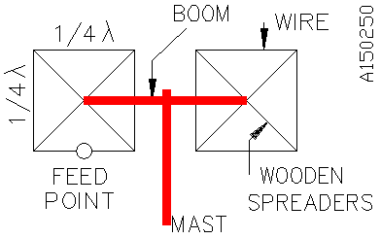
CHAPTER 8 - ANTENNAS
The Quad Antenna
Similar construction dimensions to that of the Yagi
  Reflectors are 5% longer, directors 5% shorter than driven element.
  Elements can be spaced 0.1 λ apart.
  Can also be stacked.

Slide 62
CHAPTER 8 - ANTENNAS
The Quad Antenna
Advantages and disadvantages:
  More gain than a Yagi for the same number of elements.
  Smaller footprint.
  It is a three dimension antenna.
  Usually not as ruggedly built as a similar sized Yagi.

Slide 63
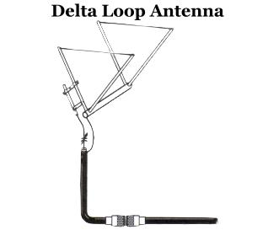
CHAPTER 8 - ANTENNAS
The Delta Antenna
Similar to a quad antenna.
Slightly more straightforward construction.

